Slide 1
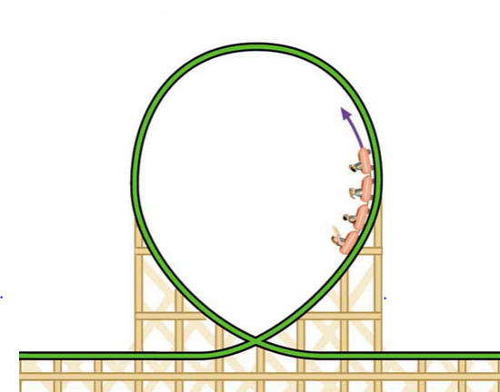
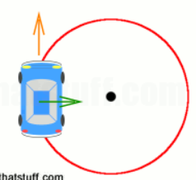
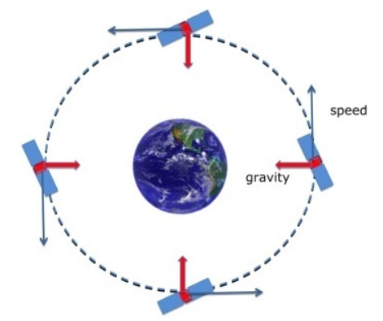
CIRCULAR MOTION
Cat Garland
Claire DeChant

Slide 2
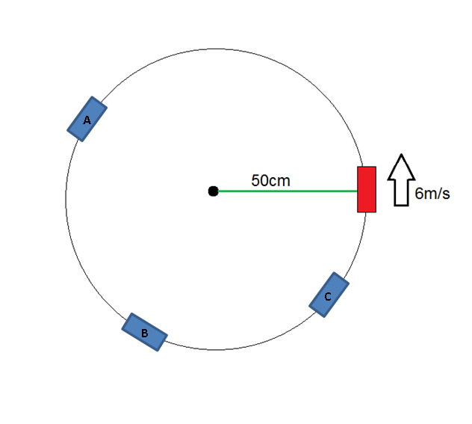
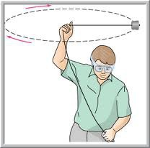

Slide 3
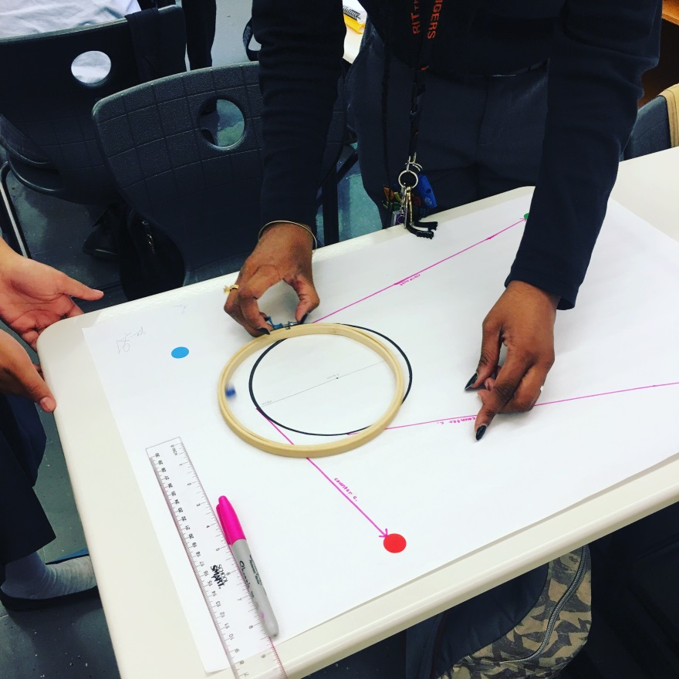

Slide 4
TODAY’S PLAN
Introductions
Initial Ideas: Card Sort
Circular Motion Stations: Whiteboard Findings + Classroom Applications
Sense-Making: Hoops and Vectors
Circle Up! Circle Up!

Slide 5
EARTH ON STRING
Compare what it feels like to rotate vertically versus horizontally.
Predict trajectory if release string.
Construct an explanation.
What could this ball and string be a model for?

Slide 6
MARBLES AND HOOPS
1. Practice with your partner until you can get your marble rolling inside the wooden hoop at an approximately constant speed.
2. Predict: Once your marble is in uniform circular motion and you lift up the hoop, do you think the marble will:
Move in a straight line?
Move in a curved path?
Stop?
3. Try it! Which did your marble do?
4. In your own words, explain why the marble followed the path it did when the hoop was removed.
5. Your teacher will place four targets on your paper. Your goal is to figure out at what points in your marble’s circular motion to lift the hoop so that the marble will hit each target.
(a) For each target, indicate the release location on the circular path.
(b) For each release location, draw and label the instantaneous velocity vector and the centripetal acceleration vector.

